Slide 1
Chapter 8
DISCRETIZATION
Cios / Pedrycz / Swiniarski / Kurgan

Slide 2
Outline
Why to Discretize Data Attributes
Unsupervised Discretization Algorithms
  Equal Width
  Equal Frequency
Supervised Discretization Algorithms
- Information Theoretic Algorithms
- CAIM
    - χ² Discretization
    - Maximum Entropy Discretization
    - CAIR Discretization
- Other
- K-means clustering
- One-level Decision Tree
- Dynamic Attribute
- Paterson and Niblett

Slide 3
Why to Discretize?
The goal of discretization is to reduce the number of values a continuous attribute assumes by grouping them into a number, n, of intervals (bins).
Discretization is often a required preprocessing step for many supervised learning methods.

Slide 4
Why to Discretize?
Discretization algorithms can be divided into:
unsupervised vs. supervised – unsupervised algorithms do not use class information

Slide 5
Why to Discretize?
x
Illustration of the supervised vs. unsupervised discretization concept

Slide 6
Why to Discretize?
Discretization algorithms can be divided into:
static vs. dynamic
Discretization of continuous attributes is most often performed one attribute at a time, independent of other attributes. This approach is known as static attribute discretization.
Dynamic algorithm searches for all possible intervals for all features simultaneously.

Slide 7
Why to Discretize?
Discretization algorithms can be divided into:
local vs. global
If partitions produced apply only to localized regions of the example/instance space they are called local
(like the one performed by the decision tree algorithms where not all features are discretized).
On the other hand, when all attributes are discretized they produce n1 x n2 x …nd regions, where ni is the number of intervals of the ith attribute; such methods are called global.

Slide 8
Why to Discretize?
Any discretization process consists of two basic steps:
- first, the number of discrete intervals needs to be decided. It is usually done by the user, although a few discretization algorithms are able to do it on their own.
- second, the width (boundary) of each interval must be determined, which is often done by a discretization algorithm itself.

Slide 9
Why to Discretize?
Problems:
Number of discretization intervals:
large number – more of the original information is retained
small number – the new feature is “easier” for subsequently used learning algorithms
Computational complexity - should be low since this is only a preprocessing step

Slide 10
Why to Discretize?
Discretization scheme depends on the search procedure
The search can start at a minimum number of discretizing points and find the optimal number of discretizing points as search proceeds
Or it can begin at a maximum number of discretizing points and search towards a smaller number of the points, which defines the optimal discretization

Slide 11
Why to Discretize?
Search criteria and the search scheme must be determined a priori to guide the search towards final optimal discretization
Stopping criteria has to be chosen to determine the optimal number, and location of discretization points

Slide 12
Heuristics for guessing the # of intervals
1. It should not be smaller than the number of classes one wants to recognize
2. The rule of thumb formula:
n_{Fi}= M / (3*C)
where:
M – number of training examples
C – number of classes
F_{i} – i^{th} attribute

Slide 13
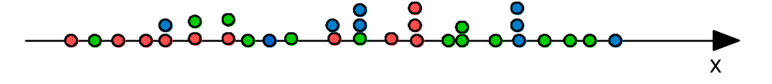
Unsupervised Discretization
Example:
c = 3 (green, blue, red)
M=33
discretization intervals
n_{Fi} = M / (3*c) = 33 / (3*3) = 4

Slide 14
Unsupervised Discretization
Equal Width Discretization
Find the minimum and maximum values for the continuous feature/attribute F_{i}
Divide the range of the attribute F_{i} into the user-specified, n_{Fi} ,equal-width discrete intervals

Slide 15
Unsupervised Discretization
Equal Width Discretization
Example:
n_{Fi} = M / (3*c) = 33 / (3*3) = 4
min max

Slide 16
Unsupervised Discretization
Equal Width Discretization
No search strategy
The number of intervals is specified by the user or calculated by the rule of thumb formula
The number of the intervals should be larger than the number of classes, to retain information between class labels and intervals

Slide 17
Unsupervised Discretization
Equal Width Discretization
Disadvantage:
If continuous values of the discretized attribute are not distributed evenly a large amount of information can be lost
Advantage:
If the number of intervals is large enough (i.e. the width of each interval is small), the information present in the discretized interval is not lost

Slide 18
Unsupervised Discretization
Equal Frequency Discretization
Sort values of the discretized feature F_{i} in ascending order
Find the number of all possible values for feature F_{i}
Divide the values of feature F_{i} into the user-specified n_{Fi} number of intervals, where each interval contains the same number of sorted sequential values

Slide 19
Unsupervised Discretization
Equal Frequency Discretization
Example:
n_{Fi} = M / (3*c) = 33 / (3*3) = 4
values/interval = 33 / 4 = 8
Statistics tells us that no fewer than 5 points should be in any given interval/bin.
min max

Slide 20
Unsupervised Discretization
Equal Frequency Discretization
No search strategy
The number of intervals is specified by the user or calculated by the rule of thumb formula
The number of intervals should not be smaller than the number of classes to retain the information between class labels and intervals

Slide 21
Supervised Discretization
Information Theoretic Algorithms
- CAIM
    - χ² Discretization
    - Maximum Entropy Discretization
    - CAIR Discretization

Slide 22
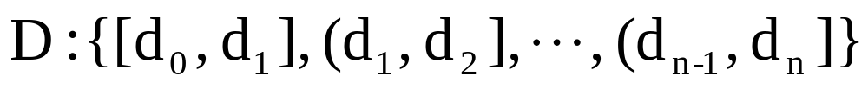
Information-Theoretic Algorithms
Given a training dataset consisting of M examples that belong to only one of the S classes. Let F indicate a continuous attribute/feature. There exists a discretization scheme D on F that discretizes the continuous attribute F into n discrete intervals, bounded by the pairs of numbers:
where d0 is the minimal value and dn is the maximal value of attribute F, and the values are arranged in the ascending order.
These values constitute the boundary set for discretization D:
{d0, d1, d2, …, dn-1, dn}

Slide 23
Information-Theoretic Algorithms
Quanta matrix
qir is the total number of continuous values belonging to the ith class that are within interval (dr-1, dr]
Mi+ is the total number of objects belonging to the ith class
M+r is the total number of continuous values of attribute F that are within the interval (dr-1, dr], for i = 1,2…,S and, r = 1,2, …, n.
Class | Interval |  |  |  |  |  | Class Total
 | [d₀, d₁] | … | (d_{r-1}, d_{r}] | … | (d_{n-1}, d_{n}]
C₁ : C_{i} : C_{S} | q₁₁ : q_{i1} : q_{S1} | … … … … … | q_{1r} : q_{ir} : q_{Sr} | … … … … … |  | q_{1n} : q_{in} : q_{Sn} | M₁₊ : M_{i+} : M_{S+}
Interval Total | M₊₁ | … | M_{+r} | … |  | M_{+n} | M

Slide 24
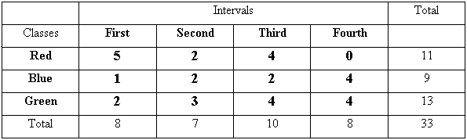
Information-Theoretic Algorithms
c = 3
r_{j} = 4
M=33

Slide 25
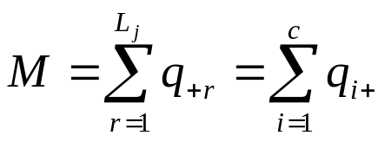
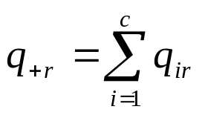
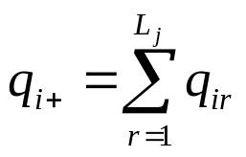
Information-Theoretic Algorithms
Total number of values:
M = 8 + 7 + 10 + 8 = 33
M = 11 + 9 + 13 = 33
Number of values in the First interval:
q_{+first} = 5 + 1 + 2 = 8
Number of values in the Red class:
q_{red+}= 5 + 2 + 4 + 0 = 11

Slide 26
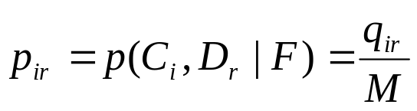
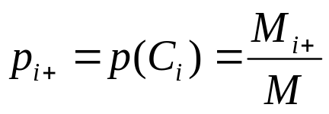
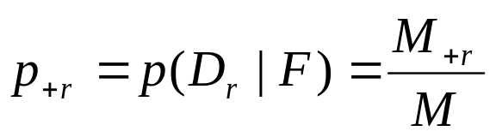
Information-Theoretic Algorithms
The estimated joint probability of the occurrence that attribute F values are within interval Dr = (dr-1, dr] and belong to class Ci is calculated as:
p_{red, first} = 5 / 33 = 0.24
The estimated class marginal probability that attribute F values belong to class Ci, pi+, and the estimated interval marginal probability that attribute F values are within the interval Dr = (dr-1, dr] p+r , are:
p_{red+}= 11 / 33
p_{+first} = 8 / 33

Slide 27
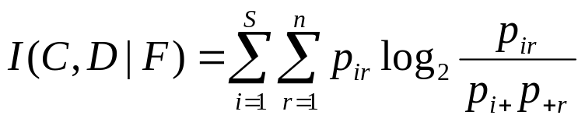
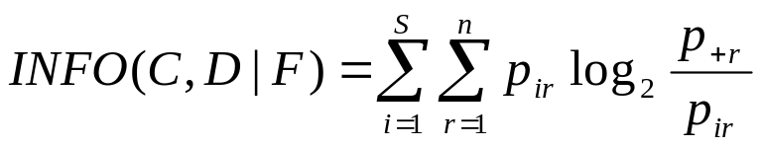
Information-Theoretic Algorithms
Class-Attribute Mutual Information between the class variable C and the discretization variable D for attribute F is defined as:
I = 5/33*log((5/33) /(11/33*8/33)) + …+ 4/33*log((4/33)/(13/33)*8/33))
Class-Attribute Information is defined as:
INFO = 5/33*log((8/33)/(5/33)) + …+ 4/33*log((8/33)/(4/33))

Slide 28
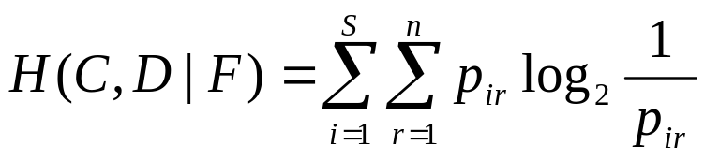
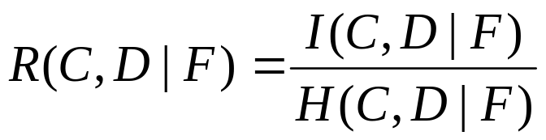
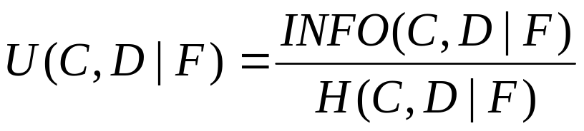
Information-Theoretic Algorithms
Shannon’s entropy of the quanta matrix is defined as:
H = 5/33*log(1 /(5/33)) + …+ 4/33*log(1/(4/33))
Class-Attribute Interdependence Redundancy (CAIR, or R) is the I normalized by entropy H:
Class-Attribute Interdependence Uncertainty (U) is the INFO normalized by entropy H:

Slide 29
Information-Theoretic Algorithms
The entropy measures randomness of distribution of data points, with respect to class variable and interval variable
The CAIR measure (a normalized entropy measure) measures Class-Attribute interdependence relationship
GOAL
Discretization should maximize the interdependence between class labels and the attribute variables and at the same time minimize the number of intervals

Slide 30
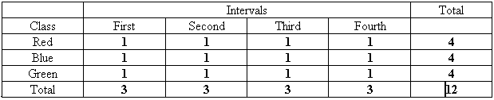
Information-Theoretic Algorithms
Maximum value of entropy H occurs when all elements of the quanta matrix are equal (the worst case - “chaos”)
q = 1
p_{sr}=1/12
p_{+r}=3/12
I = 12* 1/12*log(1) = 0
INFO = 12* 1/12*log((3/12)/(1/12)) = log(C) = 1.58
H = 12* 1/12*log(1/(1/12)) = 3.58
R = I / H = 0
U = INFO / H = 0.44

Slide 31
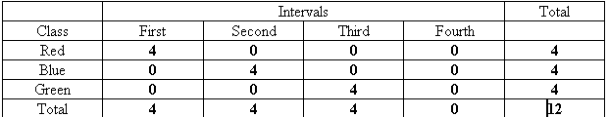
Information-Theoretic Algorithms
The minimum value of entropy H occurs when each row of the quanta matrix contains only one nonzero value (“dream case” - perfect discretization)
p_{+r}=4/12 (for the first, second and third intervals)
p_{s+}=4/12
I = 3* 4/12*log((4/12)/(4/12*4/12)) = 1.58
INFO = 3* 4/12*log((4/12)/(4/12)) = log(1) = 0
H = 3* 4/12*log(1/(4/12)) = 1.58
R = I / H = 1
U = INFO/ H = 0

Slide 32
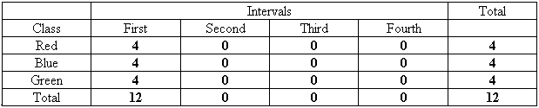
Information-Theoretic Algorithms
The quanta matrix contains only one non-zero column.
This interval equally well describes all three classes.
p_{+r}=1 (for the First interval)
p_{s+}=4/12
I = 3* 4/12*log((4/12)/(4/12*12/12)) = log(1) = 0
INFO = 3* 4/12*log((12/12)/(4/12)) = 1.58
H = 3* 4/12*log(1/(4/12)) = 1.58
R = I / H = 0
U = INFO / H = 1

Slide 33

Information-Theoretic Algorithms
Parameters for the analyzed above cases:
^^
The goal of discretization is to find a partition scheme that
a) maximizes the interdependence and
b) minimizes the information loss
between the class variable and the interval scheme.
All measures capture the relationship between the class variable and the attribute values; we will use:
Maximize R (CAIR)
Minimize U

Slide 34
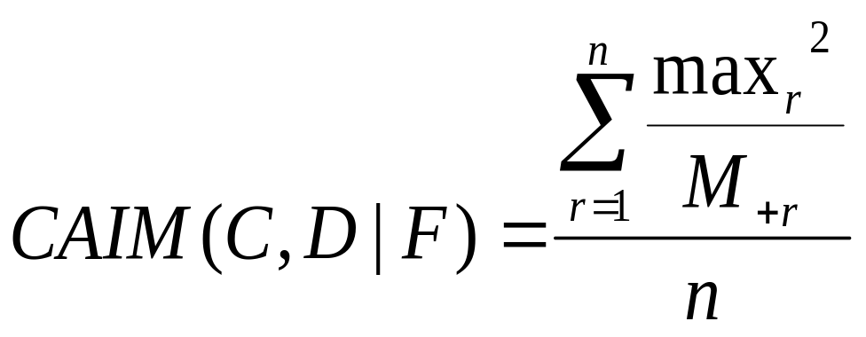
CAIM Algorithm
CAIM discretization criterion
where:
n is the number of intervals
r iterates through all intervals, i.e. r = 1, 2 ,..., n
maxr is the maximum value among all qir values (maximum in the rth column of the quanta matrix), i = 1, 2, ..., S,
M+r is the total number of continuous values of attribute F that are within the interval (dr-1, dr]
Class | Interval |  |  |  |  |  | Class Total
 | [d₀, d₁] | … | (d_{r-1}, d_{r}] | … | (d_{n-1}, d_{n}]
C₁ : C_{i} : C_{S} | q₁₁ : q_{i1} : q_{S1} | … … … … … | q_{1r} : q_{ir} : q_{Sr} | … … … … … |  | q_{1n} : q_{in} : q_{Sn} | M₁₊ : M_{i+} : M_{S+}
Interval Total | M₊₁ | … | M_{+r} | … |  | M_{+n} | M
Quanta matrix:

Slide 35
CAIM Algorithm
CAIM discretization criterion
The larger the value of the CAIM ([0, M], where M # of values of attribute F) the higher the interdependence between the class labels and the intervals
The algorithm favors discretization schemes where each interval contains majority of its values grouped within a single class label (the max_{i} values)
The squared max_{i} value is scaled by the M_{ir} to eliminate negative influence of the values belonging to other classes on the class with the maximum number of values on the entire discretization scheme
The summed-up value is divided by the number of intervals, n, to favor discretization schemes with smaller number of intervals

Slide 36
CAIM Algorithm
Given: M examples described by continuous attributes F_{i}, S classes
For every F_{i} do:
Step1
1.1 find maximum (d_{n}) and minimum (d_{o}) values
1.2 sort all distinct values of F_{i} in ascending order and initialize all possible interval boundaries, B, with the minimum, maximum, and the midpoints, for all adjacent pairs
1.3 set the initial discretization scheme to D:{[d_{o},d_{n}]}, set variable GlobalCAIM=0
Step2
2.1 initialize k=1
2.2 tentatively add an inner boundary, which is not already in D, from set B, and calculate the corresponding CAIM value
2.3 after all tentative additions have been tried, accept the one with the highest corresponding value of CAIM
2.4 if (CAIM >GlobalCAIM or k<S) then update D with the accepted, in step 2.3, boundary and set the GlobalCAIM=CAIM, otherwise terminate
2.5 set k=k+1 and go to 2.2
Result: Discretization scheme D

Slide 37
CAIM Algorithm
Uses greedy top-down approach that finds local maximum values of CAIM. Although the algorithm does not guarantee finding the global maximum of the CAIM criterion it is effective and computationally efficient:
O(M log(M))
It starts with a single interval and divides it iteratively using for the division the boundaries that resulted in the highest values of the CAIM
The algorithm assumes that every discretized attribute needs at least the number of intervals that is equal to the number of classes

Slide 38





CAIM Algorithm Example
iteration max CAIM # intervals
1 16.7 1
2 37.5 2
3 46.1 3
3 46.1 3
4 34.7 4
Discretization scheme generated by the CAIM algorithm
raw data (red = Iris-setosa, blue = Iris-versicolor, black = Iris-virginica)

Slide 39
CAIM Algorithm Experiments
The CAIM’s performance is compared with 5 state-of-the-art discretization algorithms:
two unsupervised: Equal-Width and Equal Frequency
three supervised: Patterson-Niblett, Maximum Entropy, and CADD
  All 6 algorithms are used to discretize four mixed-mode datasets.
  Quality of the discretization is evaluated based on the CAIR criterion value, the number of generated intervals, and the time of execution.
The discretized datasets are used to generate rules by the CLIP4 machine learning algorithm. The accuracy of the generated rules is
compared for the 6 discretization algorithms over the four datasets.
NOTE: CAIR criterion was used in the CADD algorithm to evaluate class-attribute interdependency

Slide 40





CAIM Algorithm Example
Algorithm #intervals CAIR value
Equal Width 4 0.59
Equal Frequency 4 0.66
Paterson-Niblett 12 0.53
Max. Entropy 4 0.47
CADD 4 0.74
CAIM 3 0.82
Discretization scheme generated by the CAIM algorithm
Discretization scheme generated by the CADD algorithm
Discretization scheme generated by the Equal Width algorithm
Discretization scheme generated by the Equal Frequency algorithm
Discretization scheme generated by the Paterson-Niblett algorithm
Discretization scheme generated by the Maximum Entropy algorithm
raw data (red = Iris-setosa, blue = Iris-versicolor, black = Iris-virginica)

Slide 41
CAIM Algorithm Experiments
Properties | Datasets
 | Iris | sat | thy | wav | ion | smo | Hea | pid
# of classes | 3 | 6 | 3 | 3 | 2 | 3 | 2 | 2
# of examples | 150 | 6435 | 7200 | 3600 | 351 | 2855 | 270 | 768
# of training / testing examples | 10 x CV | 10 x CV | 10 x CV | 10 x CV | 10 x CV | 10 x CV | 10 x CV | 10 x CV
# of attributes | 4 | 36 | 21 | 21 | 34 | 13 | 13 | 8
# of continuous attributes | 4 | 36 | 6 | 21 | 32 | 2 | 6 | 8
CV – cross validation

Slide 42
CAIM Algorithm Experiments
Criterion | Discretization Method | Dataset
 |  | iris | std | sat | std | thy | std | wav | std | ion | std | smo | std | hea | std | pid | std
CAIR mean value through all intervals | Equal Width | 0.40 | 0.01 | 0.24 | 0 | 0.071 | 0 | 0.068 | 0 | 0.098 | 0 | 0.011 | 0 | 0.087 | 0 | 0.058 | 0
 | Equal Frequency | 0.41 | 0.01 | 0.24 | 0 | 0.038 | 0 | 0.064 | 0 | 0.095 | 0 | 0.010 | 0 | 0.079 | 0 | 0.052 | 0
 | Paterson-Niblett | 0.35 | 0.01 | 0.21 | 0 | 0.144 | 0.01 | 0.141 | 0 | 0.192 | 0 | 0.012 | 0 | 0.088 | 0 | 0.052 | 0
 | Maximum Entropy | 0.30 | 0.01 | 0.21 | 0 | 0.032 | 0 | 0.062 | 0 | 0.100 | 0 | 0.011 | 0 | 0.081 | 0 | 0.048 | 0
 | CADD | 0.51 | 0.01 | 0.26 | 0 | 0.026 | 0 | 0.068 | 0 | 0.130 | 0 | 0.015 | 0 | 0.098 | 0.01 | 0.057 | 0
 | IEM | 0.52 | 0.01 | 0.22 | 0 | 0.141 | 0.01 | 0.112 | 0 | 0.193 | 0.01 | 0.000 | 0 | 0.118 | 0.02 | 0.079 | 0.01
 | CAIM | 0.54 | 0.01 | 0.26 | 0 | 0.170 | 0.01 | 0.130 | 0 | 0.168 | 0 | 0.010 | 0 | 0.138 | 0.01 | 0.084 | 0
# of intervals | Equal Width | 16 | 0 | 252 | 0 | 126 | 0.48 | 630 | 0 | 640 | 0 | 22 | 0.48 | 56 | 0 | 106 | 0
 | Equal Frequency | 16 | 0 | 252 | 0 | 126 | 0.48 | 630 | 0 | 640 | 0 | 22 | 0.48 | 56 | 0 | 106 | 0
 | Paterson-Niblett | 48 | 0 | 432 | 0 | 45 | 0.79 | 252 | 0 | 384 | 0 | 17 | 0.52 | 48 | 0.53 | 62 | 0.48
 | Maximum Entropy | 16 | 0 | 252 | 0 | 125 | 0.52 | 630 | 0 | 572 | 6.70 | 22 | 0.48 | 56 | 0.42 | 97 | 0.32
 | CADD | 16 | 0.71 | 246 | 1.26 | 84 | 3.48 | 628 | 1.43 | 536 | 10.26 | 22 | 0.48 | 55 | 0.32 | 96 | 0.92
 | IEM | 12 | 0.48 | 430 | 4.88 | 28 | 1.60 | 91 | 1.50 | 113 | 17.69 | 2 | 0 | 10 | 0.48 | 17 | 1.27
 | CAIM | 12 | 0 | 216 | 0 | 18 | 0 | 63 | 0 | 64 | 0 | 6 | 0 | 12 | 0 | 16 | 0

Slide 43
CAIM Algorithm Experiments
Algorithm | Discretization Method | Datasets
 |  | iris |  | sat |  | thy |  | wav |  | ion |  | smo |  | pid |  | hea
 |  | # | std | # | std | # | std | # | std | # | std | # | std | # | std | # | std
CLIP4 | Equal Width | 4.2 | 0.4 | 47.9 | 1.2 | 7.0 | 0.0 | 14.0 | 0.0 | 1.1 | 0.3 | 20.0 | 0.0 | 7.3 | 0.5 | 7.0 | 0.5
 | Equal Frequency | 4.9 | 0.6 | 47.4 | 0.8 | 7.0 | 0.0 | 14.0 | 0.0 | 1.9 | 0.3 | 19.9 | 0.3 | 7.2 | 0.4 | 6.1 | 0.7
 | Paterson-Niblett | 5.2 | 0.4 | 42.7 | 0.8 | 7.0 | 0.0 | 14.0 | 0.0 | 2.0 | 0.0 | 19.3 | 0.7 | 1.4 | 0.5 | 7.0 | 1.1
 | Maximum Entropy | 6.5 | 0.7 | 47.1 | 0.9 | 7.0 | 0.0 | 14.0 | 0.0 | 2.1 | 0.3 | 19.8 | 0.6 | 7.0 | 0.0 | 6.0 | 0.7
 | CADD | 4.4 | 0.7 | 45.9 | 1.5 | 7.0 | 0.0 | 14.0 | 0.0 | 2.0 | 0.0 | 20.0 | 0.0 | 7.1 | 0.3 | 6.8 | 0.6
 | IEM | 4.0 | 0.5 | 44.7 | 0.9 | 7.0 | 0.0 | 14.0 | 0.0 | 2.1 | 0.7 | 18.9 | 0.6 | 3.6 | 0.5 | 8.3 | 0.5
 | CAIM | 3.6 | 0.5 | 45.6 | 0.7 | 7.0 | 0.0 | 14.0 | 0.0 | 1.9 | 0.3 | 18.5 | 0.5 | 1.9 | 0.3 | 7.6 | 0.5
C5.0 | Equal Width | 6.0 | 0.0 | 348.5 | 18.1 | 31.8 | 2.5 | 69.8 | 20.3 | 32.7 | 2.9 | 1.0 | 0.0 | 249.7 | 11.4 | 66.9 | 5.6
 | Equal Frequency | 4.2 | 0.6 | 367.0 | 14.1 | 56.4 | 4.8 | 56.3 | 10.6 | 36.5 | 6.5 | 1.0 | 0.0 | 303.4 | 7.8 | 82.3 | 0.6
 | Paterson-Niblett | 11.8 | 0.4 | 243.4 | 7.8 | 15.9 | 2.3 | 41.3 | 8.1 | 18.2 | 2.1 | 1.0 | 0.0 | 58.6 | 3.5 | 58.0 | 3.5
 | Maximum Entropy | 6.0 | 0.0 | 390.7 | 21.9 | 42.0 | 0.8 | 63.1 | 8.5 | 32.6 | 2.4 | 1.0 | 0.0 | 306.5 | 11.6 | 70.8 | 8.6
 | CADD | 4.0 | 0.0 | 346.6 | 12.0 | 35.7 | 2.9 | 72.5 | 15.7 | 24.6 | 5.1 | 1.0 | 0.0 | 249.7 | 15.9 | 73.2 | 5.8
 | IEM | 3.2 | 0.6 | 466.9 | 22.0 | 34.1 | 3.0 | 270.1 | 19.0 | 12.9 | 3.0 | 1.0 | 0.0 | 11.5 | 2.4 | 16.2 | 2.0
 | CAIM | 3.2 | 0.6 | 332.2 | 16.1 | 10.9 | 1.4 | 58.2 | 5.6 | 7.7 | 1.3 | 1.0 | 0.0 | 20.0 | 2.4 | 31.8 | 2.9
 | Built-in | 3.8 | 0.4 | 287.7 | 16.6 | 11.2 | 1.3 | 46.2 | 4.1 | 11.1 | 2.0 | 1.4 | 1.3 | 35.0 | 9.3 | 33.3 | 2.5

Slide 44
CAIM Algorithm
Features:
fast and efficient supervised discretization algorithm applicable to class-labeled data
maximizes interdependence between the class labels and the generated discrete intervals
generates the smallest number of intervals for a given continuous attribute
when used as a preprocessing step for a machine learning algorithm significantly improves the results in terms of accuracy
automatically selects the number of intervals in contrast to many other discretization algorithms
its execution time is comparable to the time required by the simplest unsupervised discretization algorithms

Slide 45
Initial Discretization
Splitting discretization
Search starts with only one interval - the minimum value defining the lower boundary and the maximum value defining the upper boundary.
The optimal interval scheme is found by successively adding the candidate boundary points.
Merging discretization
The search starts with all boundary points
(all midpoints between two adjacent values)
as candidates for the optimal interval scheme; then some intervals are merged

Slide 46
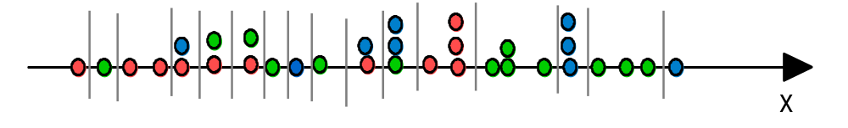
Merging Discretization Methods
χ² method
Entropy-based method
K-means discretization

Slide 47
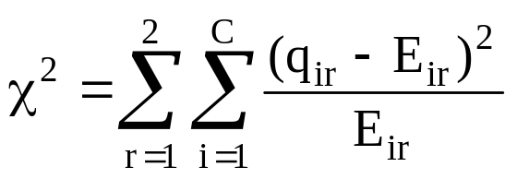
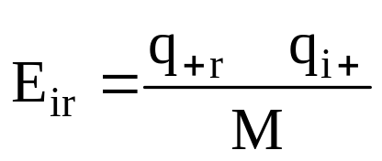
χ² Discretization Method
In the χ2 test we use the decision attribute so it is a supervised discretization method
Interval Boundary Point (BP), divides the feature values, from the range [a, b], into two parts, the left boundary point: LBP = [a, BP] and the right boundary point: RBP = (BP, b]
To measure the degree of independence between the partition defined by the decision attribute and defined by the interval BP we use the χ2 test:

Slide 48
χ² Discretization Method
If either q+r or qi+ is zero then Eir is set to 0.1. It holds that if the partitions defined by a decision attribute and by an interval boundary point BP are independent then:
P (qi+) = P (qi+ | LBP) = P (qi+ | RBP)
for any class, which means that qir = Eir for any r ∈ [1, 2] and i ∈ [1,..., C], and χ2 = 0.
Heuristic: retain interval boundaries with corresponding high value of the χ2 test and delete those with small corresponding values.

Slide 49
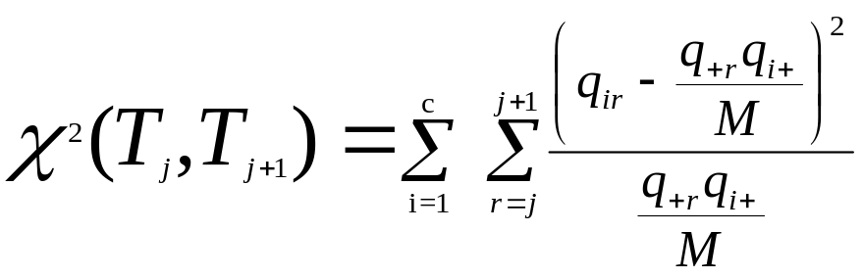
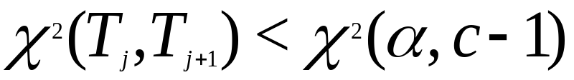
χ² Discretization Method
1. Sort the “m” examples in increasing order
2. Each value forms its own interval (“m” intervals)
3. Consider two adjacent intervals (columns) T_{j} and T _{j+1} in quanta matrix and calculate
4. Merge a pair of adjacent intervals (j and j+1) that gives the smallest value of c² and satisfies the following inequality
where alpha is the confidence interval and (c-1) is the number of degrees of freedom
5. Repeat steps 3 and 4 with (m-1) discretization intervals

Slide 50
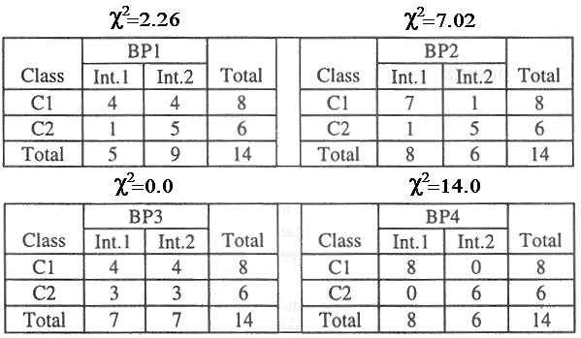
χ² Discretization Method

Slide 51
Maximum Entropy Discretization
Let T be the set of all possible discretization schemes with corresponding quanta matrices
The goal of the maximum entropy discretization is to find a t* ∈ T such that
H(t*) ≥ H(t) ∀ t ∈ T
The method ensures discretization with minimum information loss

Slide 52
Maximum Entropy Discretization
For multi-class problems it is modified, because discretization based on the maximum entropy of the quanta matrix can be highly combinatoric.
To avoid the problem of maximizing the total entropy we approximate it by maximizing the marginal entropy,
and use the boundary improvement (successive local perturbation) to maximize the total entropy of the quanta matrix.

Slide 53
Maximum Entropy Discretization
Given: Training data set consisting of M examples and C classes
For each feature DO:
1. Initial selection of the interval boundaries:
a) Calculate heuristic number of intervals = M/(3*C)
b) Set the initial boundary so that the sums of the rows for each column in the quanta matrix distribute as evenly as possible to maximize the marginal entropy
2. Local improvement of the interval boundaries
a) Boundary adjustments are made in increments of the ordered observed unique feature values to both the lower boundary and the upper boundary for each interval
b) Accept the new boundary if the total entropy is increased by such an adjustment
c) Repeat the above until no improvement can be achieved
Result: Final interval boundaries for each feature

Slide 54
Maximum Entropy Discretization
Example calculations for Petal Width attribute for Iris data
Entropy after phase I: 2.38
Entropy after phase II: 2.43
 | [0.02, 0.25] | (0.25, 1.25] | (1.25, 1.65] | (1.65, 2.55] | sum
Iris-setosa | 34 | 16 | 0 | 0 | 50
Iris-versicolor | 0 | 15 | 33 | 2 | 50
iris-virginica | 0 | 0 | 4 | 46 | 50
sum | 34 | 31 | 37 | 48 | 150
 | [0.02, 0.25] | (0.25, 1.35] | (1.35, 1.55] | (1.55, 2.55] | sum
Iris-setosa | 34 | 16 | 0 | 0 | 50
Iris-versicolor | 0 | 28 | 17 | 5 | 50
iris-virginica | 0 | 0 | 3 | 47 | 50
sum | 34 | 44 | 20 | 52 | 150

Slide 55
Maximum Entropy Discretization
Advantages:
preserves information about the given data set
Disadvantages:
hides information about the class-attribute interdependence
The resulting discretization leaves the most difficult relationship (class-attribute) to be found by the subsequently used machine learning algorithm.

Slide 56
CAIR Discretization
Class-Attribute Interdependence Redundancy
Overcomes the problem of ignoring the relationship between the class variable and the attribute values
The goal is to maximize the interdependence relationship, as measured by CAIR
The method is highly combinatoric so a heuristic local optimization method is used

Slide 57
CAIR Discretization
STEP 1: Interval Initialization
Sort unique values of the attribute in increasing order
Calculate number of intervals using the rule of thumb formula
3. Perform maximum entropy discretization on the sorted unique values – initial intervals are obtained
4. The quanta matrix is formed using the initial intervals
STEP 2: Interval Improvement
Tentatively eliminate each boundary and calculate the CAIR value
Accept the new boundaries where CAIR has the largest value
Keep updating the boundaries until there is no increase in the value of CAIR

Slide 58
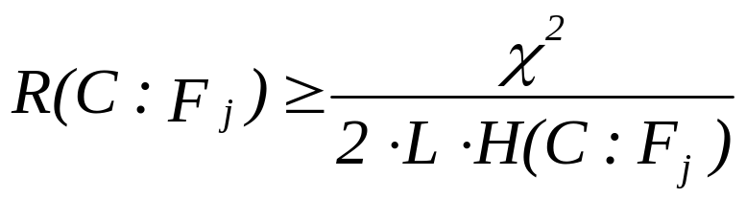

CAIR Discretization
STEP 3: Interval Reduction: Redundant (statistically insignificant) intervals are merged.
Perform this test for each adjacent interval:
where
- value at certain significance level specified by the user
L - total number of the values in two adjacent intervals
H - the entropy for the adjacent intervals; F_{j} – j^{th} feature
If the test is significant (true) at certain confidence level (say 1-0.05), the test for the next pair of intervals is performed; otherwise, adjacent intervals are merged.

Slide 59
CAIR Discretization
Disadvantages:
Uses the rule of thumb to select initial boundaries
For large number of unique values, large number of initial intervals is searched; computationally expensive
Using maximum entropy discretization to initialize the intervals results in the worst initial discretization in terms of class-attribute interdependence
The boundary perturbation can be time consuming because the search space can be large, so that the perturbation is difficult to converge
Confidence interval for the test has to be specified by the user

Slide 60
Supervised Discretization
Other Supervised Algorithms
- K-means clustering
- One-level Decision Tree
- Dynamic Attribute
- Paterson and Niblett

Slide 61
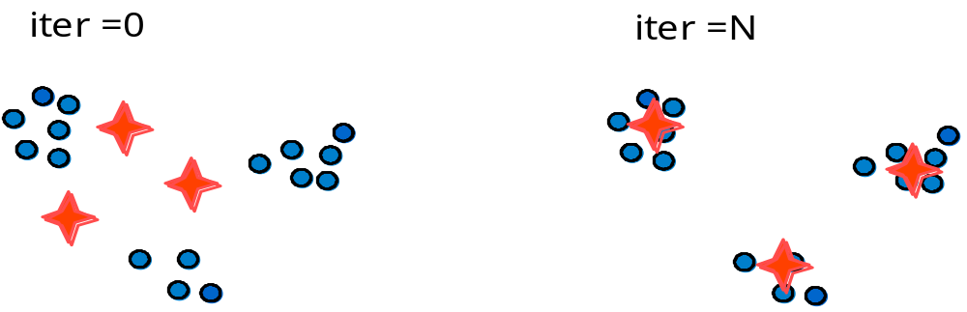
K-means Clustering Discretization
K-means clustering is an iterative method of finding clusters in multidimensional data; the user must define:
  number of clusters for each feature
  similarity function
  performance index and termination criterion

Slide 62
K-means Clustering Discretization
Given: Training data set consisting of M examples and C classes, user-defined number of intervals nFi for feature Fi
1. For class cj do ( j = 1, ..., C )
2. Choose K = nFi as the initial number of cluster centers. Initially the first K values of the feature can be selected as the cluster centers.
3. Distribute the values of the feature among the K cluster centers, based on the minimal distance criterion. As the result, feature values will cluster around the updated K cluster centers.
4. Compute K new cluster centers such that for each cluster the sum of the squared distances from all points in the same cluster to the new cluster center is minimized
5. Check if the updated K cluster centers are the same as the previous ones, if yes go to step 1; otherwise go to step 3
Result: The final boundaries for the single feature

Slide 63
K-means Clustering Discretization
Example:
cluster centers
interval’s boundaries/midpoints (min value, midpoints, max value)

Slide 64
K-means Clustering Discretization
The clustering must be done for all attribute values for each class separately.
The final boundaries for this attribute will be all of the boundaries for all the classes.
Specifying the number of clusters is the most significant factor influencing the result of discretization:
to select the proper number of clusters, we cluster the attribute into several intervals (clusters), and then calculate some measure of goodness of clustering to choose the most “correct” number of clusters

Slide 65
One-level Decision Tree Discretization
One-Rule Discretizer (1RD) Algorithm by Holte (1993)
Divides feature F_{i} range into a number of intervals, under the constraint that each interval must include at least the user-specified number of values
Starts with initial partition into some intervals, each containing the minimum number of values (like 5)
Then moves initial partition boundaries, by adding a feature value, so that the interval contains a strong majority of values from one class

Slide 66
One-level Decision Tree Discretization
Example:
x
2
x
1
x
2
b
x
1
a

Slide 67


Dynamic Discretization

Slide 68
Dynamic Discretization
IF x1= 1 AND x2= I THEN class = MINUS
(covers 10 minuses)
IF x1= 2 AND x2= II THEN class = PLUS
(covers 10 pluses)
IF x1= 2 AND x2= III THEN class = MINUS
(covers 5 minuses)
IF x1= 2 AND x2= I THEN class = MINUS MAJORITY CLASS
(covers 3 minuses & 2 pluses)
IF x1= 1 AND x2= II THEN class = PLUS MAJORITY CLASS
(covers 2 pluses & 1 minus)

Slide 69
Dynamic Discretization
IF x2= I THEN class = MINUS MAJORITY CLASS
(covers 10 minuses & 2 pluses)
IF x2= II THEN class = PLUS MAJORITY CLASS
(covers 10 pluses & 1 minus)
IF x2= III THEN class = MINUS
(covers 5 minuses)

Slide 70
References
Cios, K.J., Pedrycz, W. and Swiniarski, R. 1998. Data Mining Methods for Knowledge Discovery. Kluwer
Kurgan, L. and Cios, K.J. (2002). CAIM Discretization Algorithm, IEEE Transactions of Knowledge and Data Engineering, 16(2): 145-153
Ching J.Y., Wong A.K.C. & Chan K.C.C. (1995). Class-Dependent Discretization for Inductive Learning from Continuous and Mixed Mode Data, IEEE Transactions on Pattern Analysis and Machine Intelligence, v.17, no.7, pp. 641-651
Cios, K.J. and Kurgan, L. 2004. CLIP4: Hybrid Inductive Machine Learning Algorithm that Generates Inequality Rules. Information Sciences, 163 (1-3): 37-83

